Slide 1
Machine Learning in Medical Imaging
Project Presentation
Claus Meschede, Leonard Rychly
18. July 2016
U-Net: Convolutional Networks for Biomedical Image Segmentation
Notes:
<number>

Slide 2
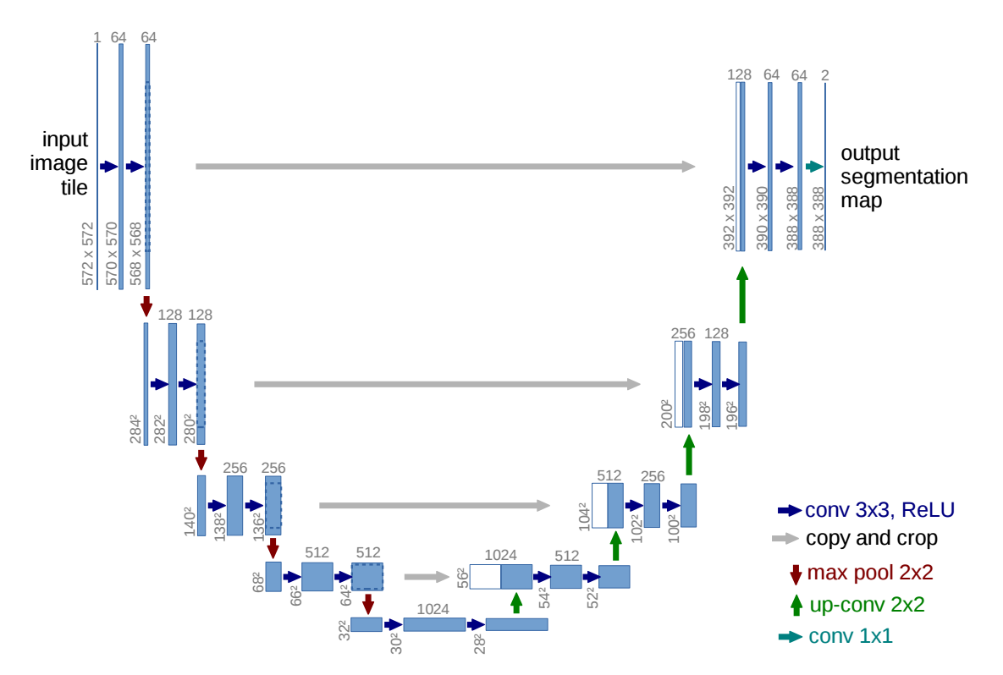
Architecture

Slide 3
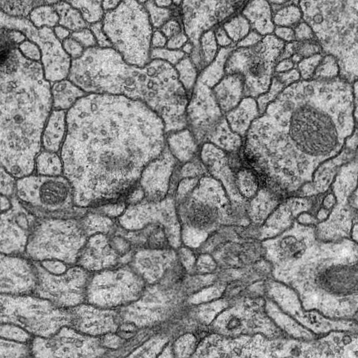
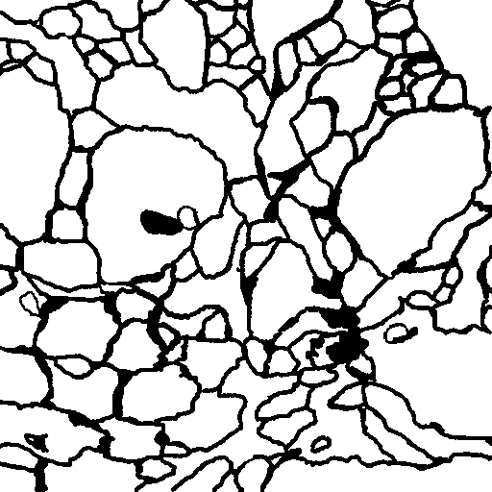
Original Task

Slide 4
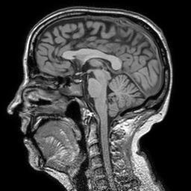
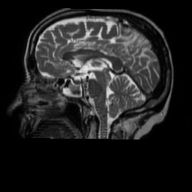
Our Task

Slide 5
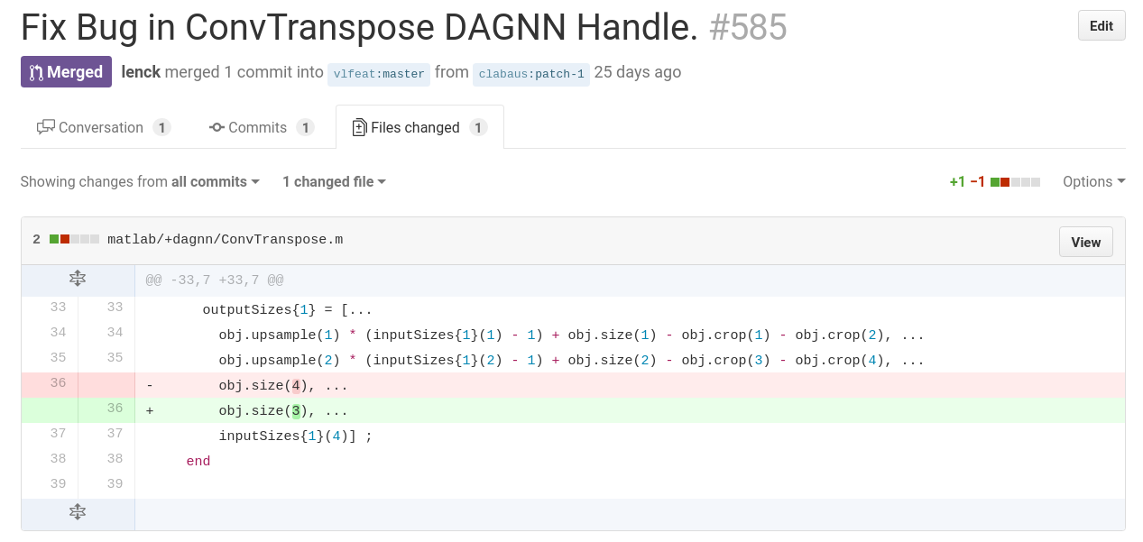
Issues - Transposed Convolutions

Slide 6
Our Task

Slide 7
Different approaches building the U-Net
Starting with a small version of the U-Net
Leaving out the “Crop and Copy”-Layers
Replacing Transposed Convolution with a Unpooling Layer
Varying number of input images

Slide 8
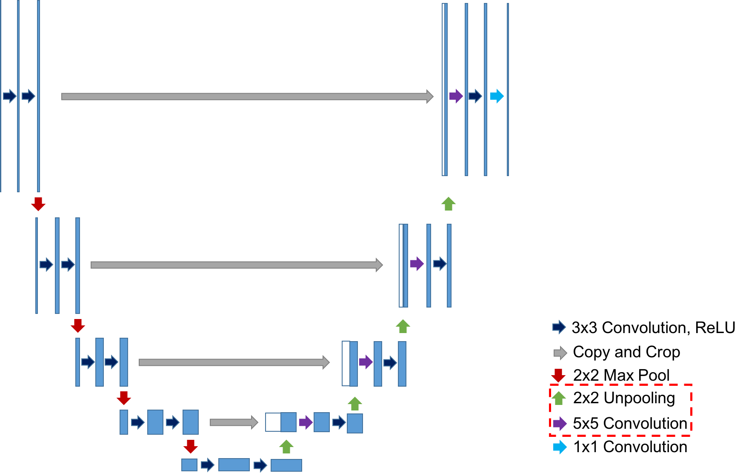
Replacing Transposed Convolution with Unpooling Layer
Input
Output

Slide 9
Replacing Transposed Convolution with Unpooling Layer Results

